Slide 1
Leveraging GPU Parallelism for Breadth-First Search Using CUDA

Slide 2
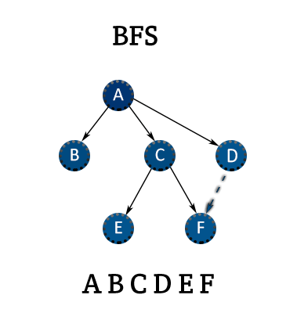
Introduction
Content:
What is BFS?
A graph traversal algorithm.
Used in applications like:
Shortest Path and Minimum Spanning Tree in graphs.
Peer-to-Peer Networks (e.g. Bittorent).
Garbage Collection (e.g. Cheney’s algorithm).
Why Accelerate BFS?
Traditional CPU-based BFS is sequential and slow.
Large graphs (millions of nodes) require high computational power.
GPUs provide massive parallelism to process multiple nodes simultaneously.

Slide 3
Objectives
Goals of this research:
Implement BFS using CUDA for parallelism.
Analyze performance gains compared to CPU-based BFS.
Explore CUDA stream optimization.
Evaluate scalability with large datasets.

Slide 4
Graph Representation in CUDA
BFS requires an efficient way to store graphs in memory.
We use Compressed Sparse Row (CSR) representation:
Vertex Array (Va): Stores the starting indices of the adjacency lists.
Edge Array (Ea): Stores adjacency lists.
Value (Val): Stores node values.

Slide 5
CUDA Implementation of BFS
Graph Preprocessing:
Load graph data and process it dividing it into the different Arrays.
Kernel Execution:
Each thread processes a single node in the active frontier.
Atomic operations ensure thread safety.
Host-Device Interaction:
Copy data between CPU and GPU.
Manage parallel execution.

Slide 6
BFS Kernel Breakdown
The kernel function bfs_kernel performs the following:
Marks a node as processed.
Explores its neighbors.
Updates distances and flags the next frontier.
Uses atomic operations (atomicMin) for safe concurrent writes.
Ensures efficient workload distribution among GPU threads.
bfs_ker(Va, Ea, Fa, Xa, Ca, num_vertex) {
tid = blockIdx.x * blockDim.x + threadIdx.x;
Fa[tid] = 0; // Mark this node as processed
Xa[tid] = 1; // Mark this node as explored
for (i = Va[tid]; i < Va[tid + 1]; ++i) {
neighbor = Ea[i];
if (!Xa[neighbor]) { // If neighbor not explored
Fa[neighbor] = 1;
atomicMin(&Ca[neighbor], Ca[tid] + 1);
}
}
}

Slide 7
CUDA Streams for Optimization
// Create CUDA streams
cudaStream_t compute_stream, transfer_stream;
cudaStreamCreate(&compute_stream);
cudaStreamCreate(&transfer_stream);
Why use CUDA streams?
Reduces kernel launch overhead.
Allows overlap of memory transfers and computation.
Implementation:
Separate compute stream and transfer stream.
Improves execution efficiency.
// use the compute_stream for the kernel call
bfs_ker<<<CALL_PARAMETERS,compute_stream>>>(CALL_TO_DEVICE);
// use the transfer_stream for the memcpy/synch calls
cudaMemcpyAsync(CALL_TO_HOST, transfer_stream);
cudaStreamSynchronize(transfer_stream);

Slide 8
Benchmarking Setup
Hardware Used:
CPU: Ryzen 5900X, 32GB DDR4 RAM.
GPUs: NVIDIA RTX 3080 (10GB VRAM).
Datasets:
Different graph sizes ranging from 10K to 10M vertices.
Metrics Measured:
Execution Time
Speedup vs CPU
CUDA Streams vs. No Streams

Slide 9
Benchmarking Results
Datasets | Vertices | Edges | Execution Time (CUDA no stream) | Execution time (CUDA stream) | Execution Time C++
Dataset 1 | 10,000 |  | 429.78 ms | 426.25 ms | 39.18 ms
Dataset 2 | 100,000 |  | 723.23 ms | 728.76 ms | 407.42 ms
Dataset 3 | 1,000,000 |  | 3.87 s | 728.76 ms | 3.88 s
Dataset 4 | 10,000,000 |  | 36.49 s | 36.10 s | 41.64 s

Slide 10
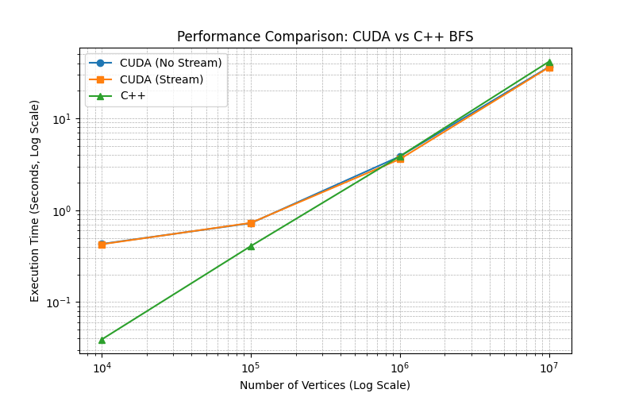

Slide 11
Observations and Insights
Key Findings:
CUDA is highly efficient for large graphs.
CSR format improves memory efficiency.
CUDA streams help but need better implementation.
Small graphs suffer from GPU overhead.
Challenges & Limitations:
High host-device communication cost.
Limited performance boost for small graphs.

Slide 12
Conclusion
Summary:
CUDA accelerates BFS for large-scale graphs.
Streams provide moderate improvements.
The CPU remains competitive for small datasets.
Future Directions:
Implement Weighted BFS (Dijkstra on GPU).
Optimize CUDA streams further.

Slide 13
References
Nvidia CUDA Toolkit Documentation.
P. Harish, P. J. Narayanan (2007). Accelerating Large Graph Algorithms on theGPU Using CUDA.
D. Merrill, M. Garland, A. Grimshaw (2012). Scalable GPU Graph Traversal.
Lijuan Luo, Martin Wong, Wen-mei Hwu (2010). An Effective GPU Implementa-tion of Breadth-First Search.

